Slide 1
Object Oriented Programming Design
Presented by
Dr Ramya Devi M
mramyadevi@wilp.bits-pilani.ac.in
CS - 02 : 05th Jul 2025

Slide 2
Module 1 – Lecture 2
BASICS IN JAVA

Slide 3
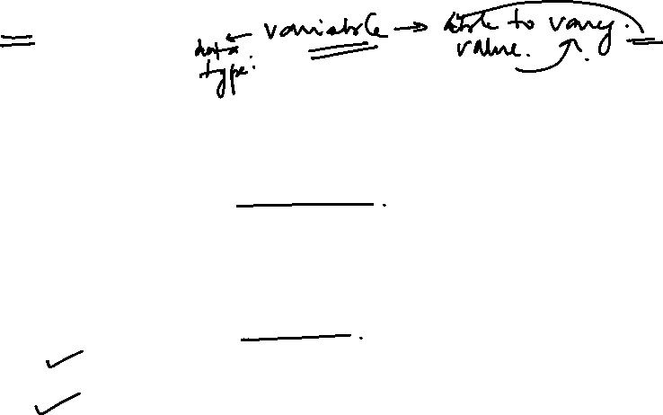
Data Types
DATATYPES
A data type informs the compiler or interpreter what type of data will be stored in the variable.
It defines the operations that can be done on the data and what type of values can be stored.
In Java, According to the properties they possess, data types are divided into two groups:
Primitive Data types
Non – Primitive Data types
Primitive Data Types: A primitive data type is pre-defined by the programming language. The size and type of variable values are specified, and it has no additional methods.
Object Oriented Programming

Slide 4
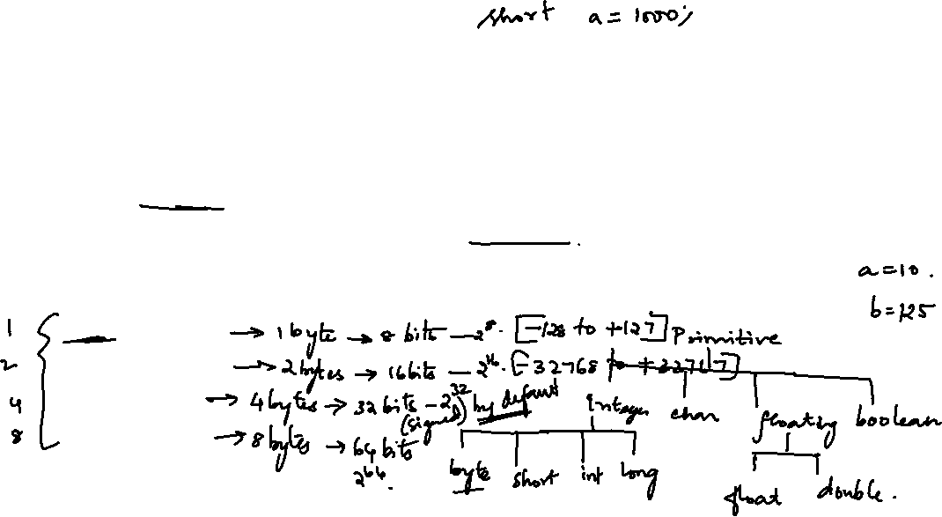
Data Types
Non-Primitive Data Types: These data types are not actually defined by the programming language but are created by the programmer.
They are also known as “reference variables” or “object references” since they refer to a memory location which stores the data.
Primitive Data Types
Data types in Java are classified into 4 categories, namely int, float, character and boolean.
The int data type is further sub-divided into four categories as follows:
byte data type
short data type
int data type
long data type
Object Oriented Programming

Slide 5
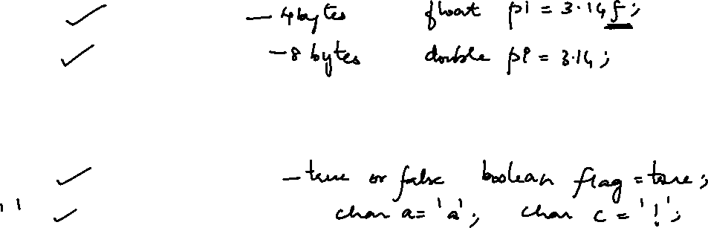
Data Types
The decimal or floating point type has two categories namely
float data type
double data type
Apart from the two numerical categories, there are two datatypes to represent characters and Boolean value namely
boolean data type
char data type
We can refer to the below figure to understand the different data types with respect to the memory allocated to them.
Object Oriented Programming

Slide 6
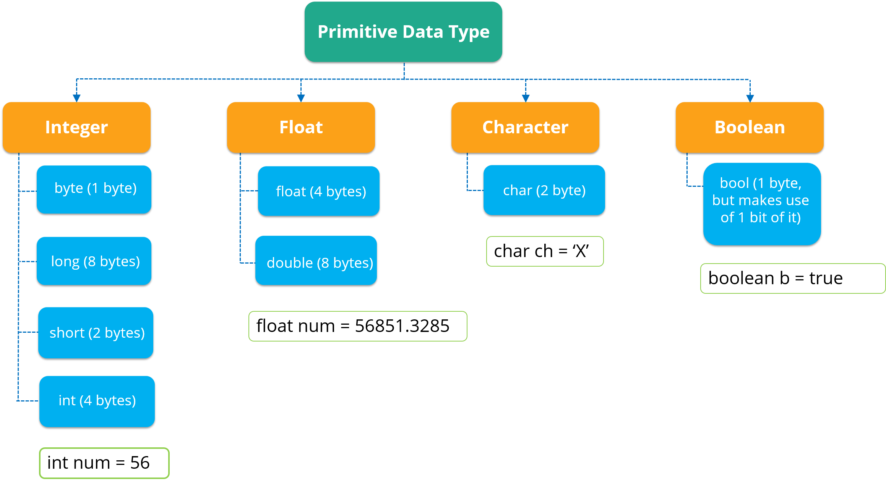

Data Types
Object Oriented Programming

Slide 7
Data Types
boolean data type
A boolean data type comprises of a bit of information and can store only true or false values.
This data type is used to control true/false conditions.
byte data type
This is an example of a primitive data type.
It is an 8-bit signed two’s complement integer.
It stores whole numbers that lie between -128 to 127.
A byte data type is helpful for saving memory in large amounts.
char data type
This data type is used to store a single character.
The character must be enclosed within single quotes, like ‘E’ or ‘e’.
Object Oriented Programming

Slide 8
Data Types
short data type
A short data type is greater than byte in terms of size and less than a integer.
It stores the value that ranges from -32,768 to 32767.
int data type
This data type can store whole numbers from -2147483648 to 2147483647.
Generally, int is the preferred data type when we create variables with a numeric value.
long data type
This data type is a 64-bit two’s complement integer.
By default, the size of a long data type is 64 bit and its value ranges from –2⁶³ to 2⁶³-1
Object Oriented Programming

Slide 9
Data Types
Floating Point Datatypes
We should use a floating point type whenever we need a number with a decimal, such as 8.88 or 3.14515.
float data type
This data type can store fractional numbers from 3.4e−038 to 3.4e+038.
double data type
The double data type can store fractional numbers from 1.7e−308 to 1.7e+308.
Note that you should end the value with a d for double and f for floating point values.
Example : double x=1.3452109d;
float y=1.3452109f;
Object Oriented Programming

Slide 10

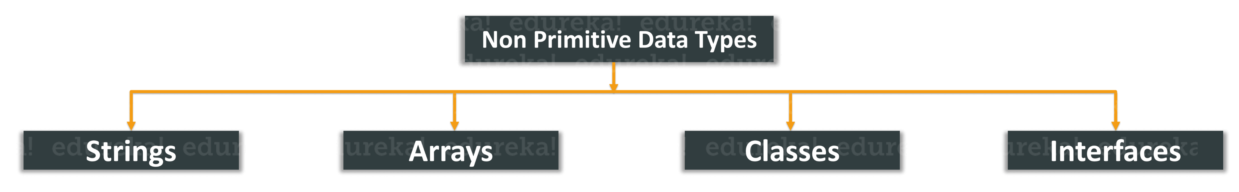
Data Types
Non-Primitive Datatypes
Non-Primitive data types refer to objects and hence they are called reference types.
Examples of non-primitive types include
Strings, Arrays, Classes, Interface, etc. Below image depicts
various non-primitive data types.
Object Oriented Programming

Slide 11
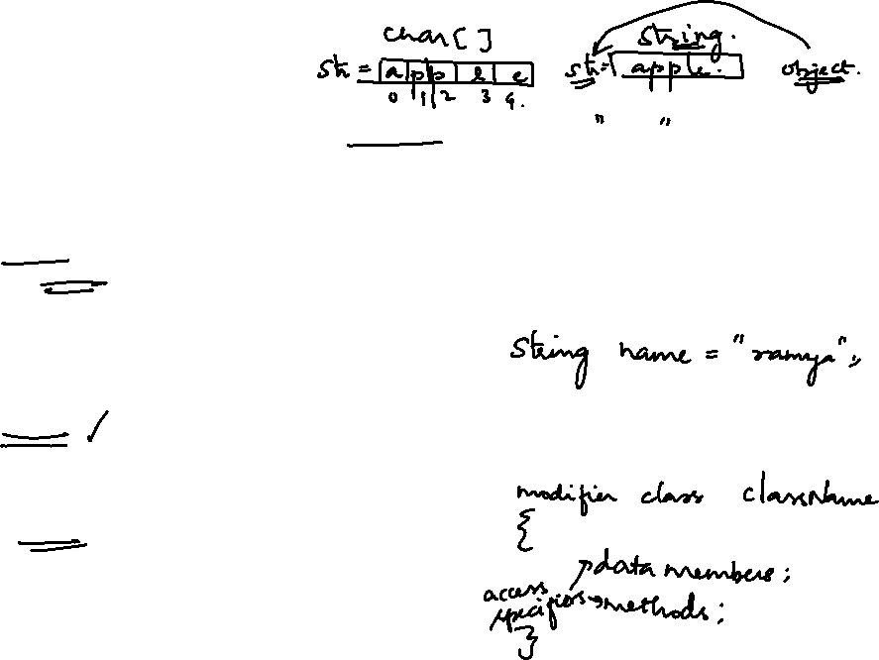
Data Types
Strings: String is a sequence of characters.
But in Java, a string is an object that represents a sequence of characters.
The java.lang.String class is used to create a string object.
Arrays: Arrays in Java are homogeneous data structures implemented in Java as objects.
Arrays store one or more values of a specific data type and provide indexed access to store the same.
A specific element in an array is accessed by its index.
Classes: A class in Java is a blueprint which includes all our data.
A class contains fields(variables) and methods to describe the behavior of an object.
Interface: Like a class, an interface can have methods and variables, but the methods declared in interface are by default abstract (only method signature, no body).
Object Oriented Programming

Slide 12
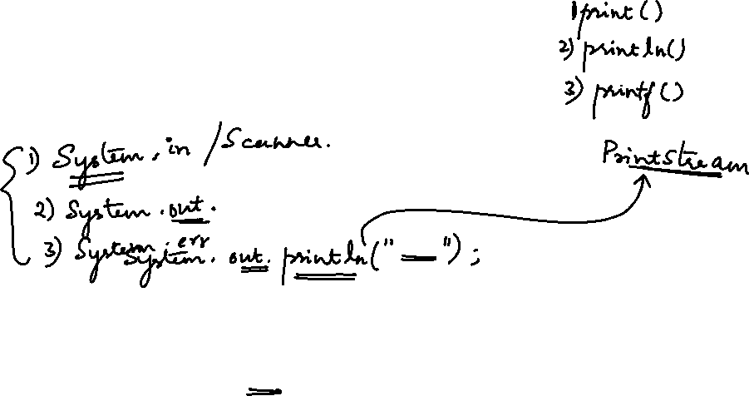
Standard I / O, Operators and Control Statements IN JAVA

Slide 13
Learning Objectives
Reading the inputs using Scanner class
Reading the inputs through command line
Displaying output on standard output device
Definition for an operator
Various types of operators
Control statements
Object Oriented Programming

Slide 14

Standard I/ O for a PROGRAM
There are various methods for getting the inputs to the program through the standard input device, Keyboard.
The following are the methods of getting user inputs to the program through the keyboard.
Input in the command line argument
Input using the Scanner class
Using Streams for input from different streams. (Console, File, etc.)
Object Oriented Programming

Slide 15
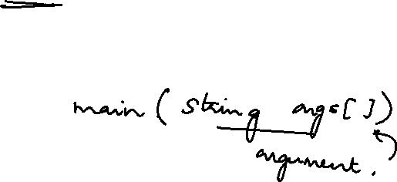
Standard I/ O for a PROGRAM
1. Getting the inputs using Command Line Argument
It is the information that is passed to the program at the time of execution.
The information passed is stored in the String array argument
In the main() method.
It is the information that directly follows the program’s name on the command line when it is running.
Object Oriented Programming

Slide 16
Getting the INPUT in Command Line
Important Points in using Command Line Arguments are:
There is no restriction on the number of java command line arguments. We can specify any number of arguments
The input Information is passed to the main() method as Strings.
They are captured into the String array of the main method
Inside the program, there should be some type conversion to convert the string into the type what we require in the program to process.
Example While running a class Demo, we can specify the inputs as command line arguments as
C:\Program\Java>java Demo arg1 arg2 arg3 ……
Object Oriented Programming

Slide 17
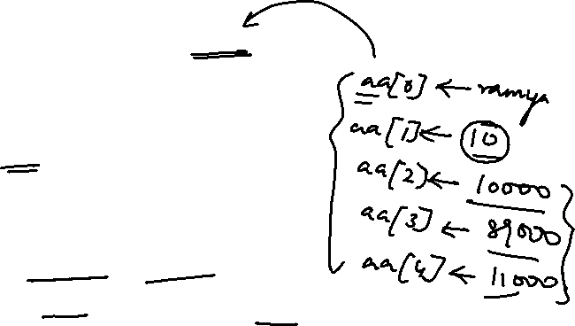
Getting the INPUT in Command Line
Example : Input through Command Line arguments
Step 1) Type the code into an editor.
Class ComLineDemo
{
public static void main(String aa[])
{
String name;
int num;
float salary, gross, ded;
name=aa[0];
num=Integer.parseInt(aa[1]);
gross=Float.parseFloat(aa[2]);
Object Oriented Programming

Slide 18
Getting the INPUT in Command Line
ded=Float.parseFloat(aa[3]);
salary=gross-ded;
System.out.println(“ Name “+name);
System.out.println(“ Number “+num);
System.out.println(“ Net Salary “+salary);
}
}
Step 2) Save & Compile the code >javac ComLineDemo.java
Step 3) Run the code as
>java ComLineDemo Virat 1995 789045.75 3456.30 aa[0] aa[1] aa[2] aa[3]
Name Num Gross Ded
Object Oriented Programming

Slide 19
Getting INPUT - Scanner
Scanner is a class in java.util package used for obtaining the input of the primitive types like int, double, etc. and Strings.
To create an object of Scanner class, we usually pass the predefined object System.in, which represents the standard input stream.
We may pass an object of class File if we want to read input from a file.
To read numerical values of a certain data type D, the function to use is nextD.
Examples:
To read a value of type short, we can use nextShort()
To read a value of type int, we can use nextInt()
To read a string, we use the function nextLine().
Object Oriented Programming

Slide 20
Getting the INPUT - Scanner
To read a single character, we use next().charAt(0). next() function returns the next token/word in the input as a string and charAt(0) function returns the first character in that string.
Example program for getting Input using SCANNER class
import java.util.*;
class ScannerDemo
{
public static void main(String aa[])
{
String name;
int num;
Object Oriented Programming

Slide 21
Getting the INPUT - Scanner
char gender;
double salary;
Scanner S=new Scanner(System.in);
System.out.println(“Enter Name and Number of EMPLOYEE”);
name=S.nextLine();
num=S.nextInt();
System.out.println(“\n Enter Gender of the EMPLOYEE”);
gender=S.next.charAt(0);
System.out.println(“\n Enter Salary of the EMPLOYEE”);
salary=S.nextDouble();
System.out.println(“\n Name of the EMPLOYEE”+name);
Object Oriented Programming

Slide 22
Getting the INPUT - Scanner
System.out.println(“\n Number of the EMPLOYEE”+num);
System.out.println(“\n Gender of the EMPLOYEE”+gender);
System.out.println(“\n Salary of the EMPLOYEE”+salary);
}
}
Note: Input from streams will be dealt in I/O streams session
Object Oriented Programming

Slide 23
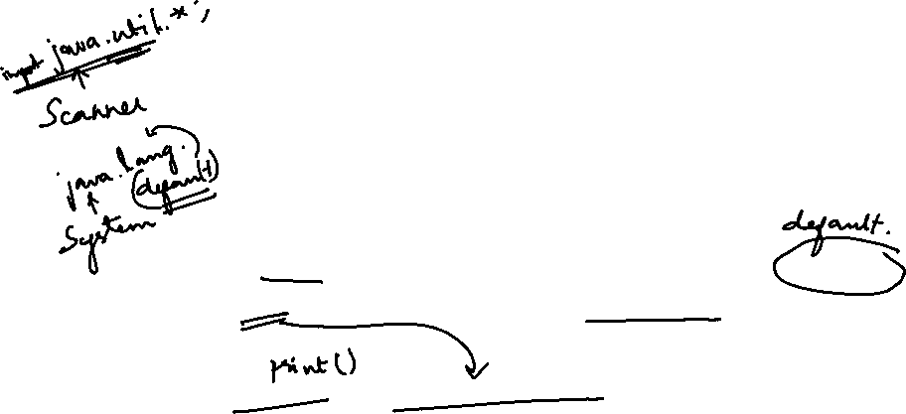
Standard Output
To display the output on the screen, we use the format
System.out.println(Data to be displayed);
Java System.out.println() is used to print an argument that is
passed to it. The statement can be broken into 3 parts which
can be understood separately as:
System - It is a final class defined in the java.lang package.
out: This is an instance of PrintStream type, which is a public
and static member field of the System class
3. println() : PrintStream class has a public method println(), which can be invoked.
This is an upgraded version of print().
It prints any argument passed to it and adds a new line to the output. System.out represents the Standard Output Stream.
Object Oriented Programming

Slide 24
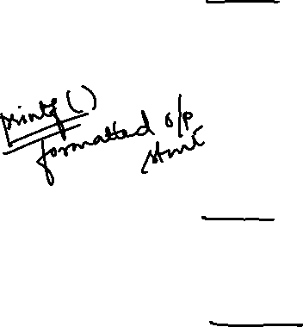
Standard Output
Example: int x=1,y=2;
System.out.println(“Sum of 10 and 20 is ”+(10+20));
System.out.println(“ X = ”+x+” Y = “+y);
The output will be
Sum of 10 and 20 is 30
X = 1 Y = 2
Difference between System.out.print() and System.out.println()
System.out.print(): This method prints the text on the console
and the cursor remains at the end of the text at the console.
The next printing takes place from just here.
System.out.println(): This method prints the text on the
console and the cursor remains at the start of the next line at
the console.
Object Oriented Programming

Slide 25
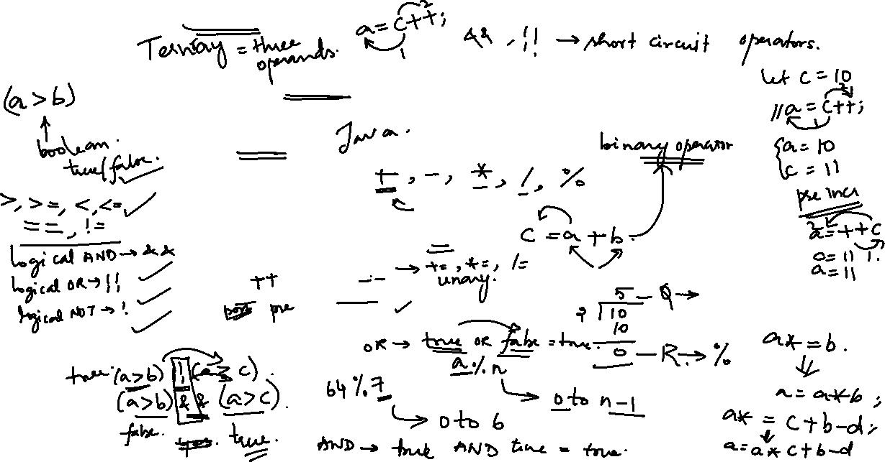
OPERATORS in JAVA
An operator is a symbol used for doing an operation. The
operators are used for mathematical or logical manipulations.
There are six types of C Operators. They are
Arithmetic Operators
Relational Operators
Logical Operators
Assignment Operators
Increment and Decrement operators
Conditional Operators
Special operators
Object Oriented Programming

Slide 26
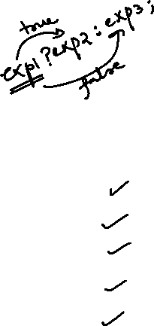
OPERATORS in JAVA
i. Arithmetic Operators: These operators used in arithmetic expressions.
An arithmetic expression is an expression in which the variables and constants are combined with the arithmetic operators. The arithmetic operators are
* - Multiplication
/ - Division
+ - Addition
- - Subtraction
% - Modulo division
Examples for arithmetic expressions
a + b % 35
  11 – a / b * ( c / 2)
Object Oriented Programming

Slide 27

OPERATORS in JAVA
ii. Relational Operators: These operators are used for defining relational expressions.
A relational expression is an expression in which the variables and constants are combined with the relational operators. The resultant value of a relational expression is either true or false. The relational operators are
< - Lesser than
> - Greater than
< = - Less than or equal to
> = - Greater than or equal to
= = - Equal to
! = - Not Equal to
Object Oriented Programming

Slide 28
OPERATORS in JAVA
Examples for relational expression :
(a) a >= b [ true if the value of a is greater than or equal to the value of b. otherwise it is false ]
(b) b = = c [ true if the value of b is equal to
the value of c, otherwise the value
is false]
(c) a < ( b + c ) [ true if the value of a is lesser than
the value of b + c , otherwise the
value of the expression is false]
Object Oriented Programming

Slide 29

OPERATORS in JAVA
iii. Logical Operators - These operators are used for combining more than one relational expressions.
A Logical expression is an expression in which the variables and constants are combined with the Logical operators.
The logical operators are
&& - AND
| | - OR
! - NOT
The general format is
Relational expression 1 logical operator relational expression 2
Examples for logical expressions:
a. ( (a > b ) && ( a > c ) )
b. ( ( Mark1 > 50 ) | | ( Mark2 > 50 ) )
Object Oriented Programming

Slide 30
OPERATORS in JAVA
iv. Assignment Operators: The general format of this operator is
variable = expression;
A special kind of assignment operator is the short-hand assignment operator given by
Variable operator = expression;
The above assignment statement is equivalent to
variable = variable operator expression;
For example:
The statement x = x * 100;
can be written as x * = 100 ; by using the assignment operator.
By using these operators , the variable on the L.H.S need not
be repeated again.
Object Oriented Programming

Slide 31
OPERATORS in JAVA
v. Increment and Decrement Operators:. These operators are used for incrementing and decrementing the value of variables.
There are two formats for writing the Increment operators. They are
1. Post increment operator which has the form Variable + +;
2. Pre increment operator which has the form + + Variable ;
Both are same till they are not assigned to variables.
Example:
Let x = 1;
Then after executing the statement x ++ ; The value of x is 2.
Instead of the post increment operator , if we use the preincrement operator ++ x, the value is also 2.
Object Oriented Programming

Slide 32
OPERATORS in JAVA
Otherwise if they are assigned to another variable, the post increment operator assigns the initial value first and then it is incremented where as the pre increment operator assigns the value after the variable is incremented.
x = 1; x = 1;
y = x ++; y = + + x;
Code 1 Code 2
For code 1 , the value of y is 1 and for the code 2 the value of y is 2. In both the cases , the value of x is 2.
Object Oriented Programming

Slide 33
OPERATORS in JAVA
Like the increment operators , there are two formats for writing
the Decrement operators. They are
1. Post Decrement operator which has the form Variable - -;
2. Pre Decrement operator which has the form - - Variable ;
Both are same till they are not assigned to variables.
Example:
Let x = 1;
Then after executing the statement x - - ; The value of x is 0.
Instead of the post decrement operator , if we use the pre decrement operator - - x, the value is also 0.
Object Oriented Programming

Slide 34
OPERATORS in JAVA
decremented where as the pre decrement operator assigns
the value after the variable is decremented.
x = 1; x = 1;
y = x - -; y = - - x;
Code 1 Code 2
For the code 1 , the value of y is 1 and for the code 2 the value
of y is 0. In both the cases , the value of x is 2.
vi. Conditional Operator : This operator is also known as the
“? :” operator or ternary operator.
The general format of the operator is
Variable = Condition ? a.e 1 : a.e 2;
Object Oriented Programming

Slide 35
OPERATORS in JAVA
Where Condition is either a relational Expression or Logical
Expression
a.e 1 and a.e 2 are arithmetic expressions.
If the condition is true, the value of the a.e 1 is assigned to the variable on the L.H.S. Otherwise , the value of a.e 2 is assigned to variable.
Example:
big = (x > y ) x : y;
for the above statement if the values of x and y are 10 and 12 ,
then big = 12 because the condition is false, so the value of the
expression 2 ( that is the value of y ) is assigned to big. If the
values of x and y are 100 and 10 , then big = 100.
Homework: Find the biggest of 3 numbers using “?:” operator
Object Oriented Programming

Slide 36
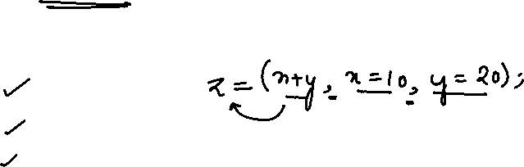
OPERATORS in JAVA
vii. Special Operators : There are some special operators
available in Java. They are
Comma operator :- It is an operator which is used to
combine more than one statements into a single statement. The statements
x = 10;
y = 20;
z = x + y;
can be written in a single statement by using the comma
operator as
z = ( x + y , x = 10 , y = 20 );
Object Oriented Programming

Slide 37
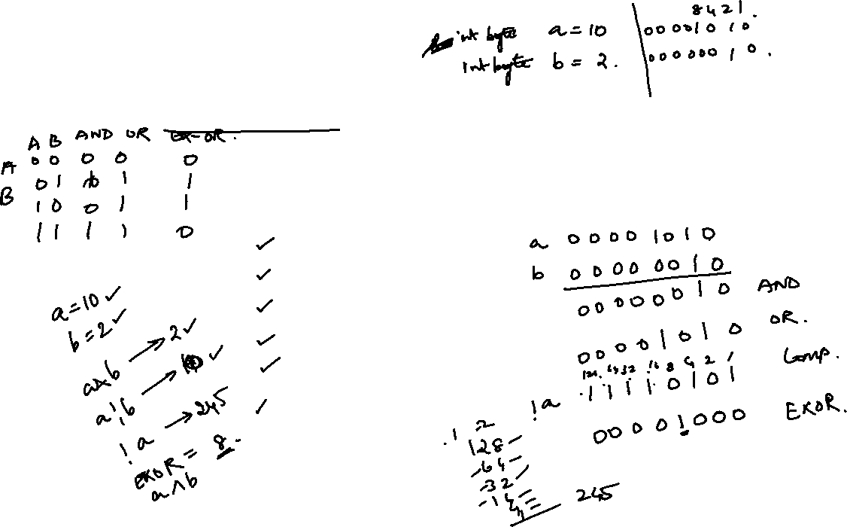
OPERATORS in JAVA
b. Bit wise operators:- Some operators can be used to do the
bit wise operations. A bit is a binary digit whose value either 0
or 1.
The Bit wise operators are
& - Bit wise AND
| - Bit wise OR
! - Complement
>> - Shift right
<< - Shift Left
        - Exclusive OR
Object Oriented Programming

Slide 38
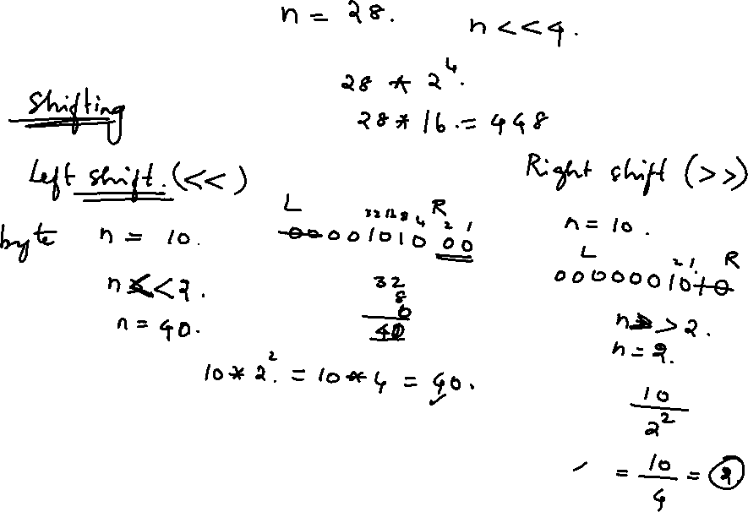

Slide 39


OPERATORS in JAVA
c. Instanceof operator
instanceof is a binary operator used to test if an object is of a given type.
The result of the operation is either true or false.
It is also known as type comparison operator.
It helps in avoiding ClassCastException at runtime.
The instanceof operator's basic syntax is:
object instanceof (Type)
The instanceof operator works on the principle of the is-a
relationship.
The concept of an is-a relationship is based on Class
inheritance or interface implementation.
Object Oriented Programming

Slide 40
OPERATORS in JAVA
Example Program
class InstanceOfDemo
{
public static void main(String aa[])
{
String s=“Example program”;
boolean b= s instanceof String;
System.out.prinltn(“\n Is it an Instance? ”+b);
}
}
The output is
Is it an Instance? true
Object Oriented Programming

Slide 41
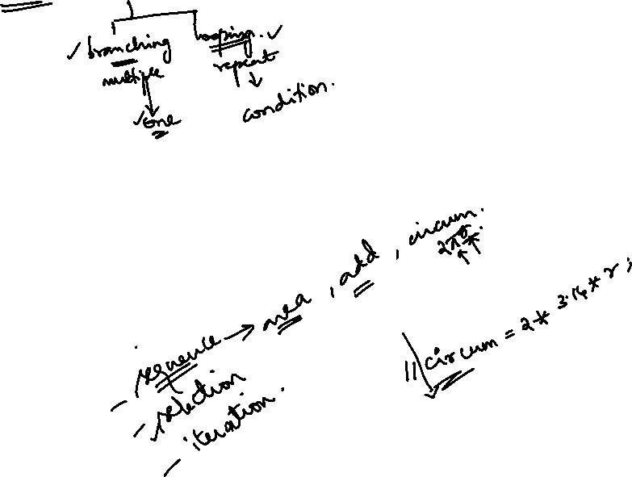
Java Control Statements | Control Flow in Java
Java compiler executes the code from top to bottom.
The statements in the code are executed according to the order in which they appear.
However, Java provides statements that can be used to control the flow of Java code.
Such statements are called control flow statements.
It is one of the fundamental features of Java, which provides a smooth flow of program.
Object Oriented Programming

Slide 42
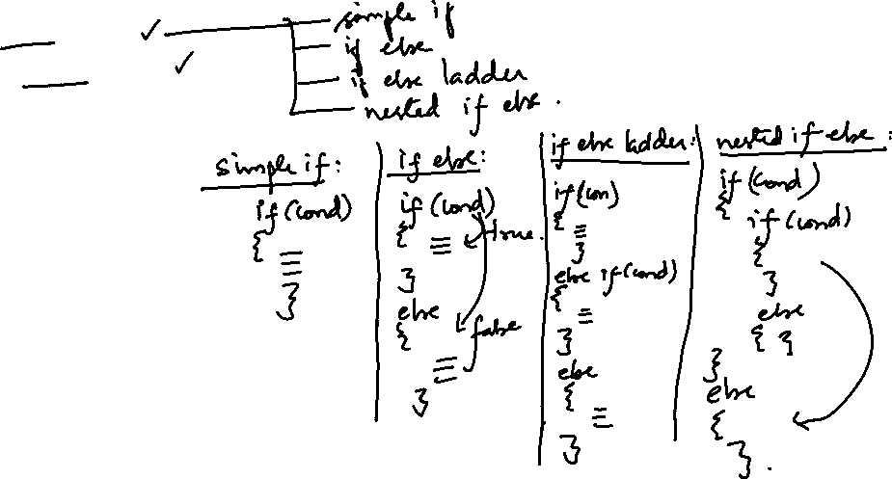
Java Control Statements
Java provides three types of control flow statements.
Decision Making statements
  if statements
  switch statement
Loop statements
  do while loop
  while loop
  for loop
  for-each loop
Jump statements
  break statement
  continue statement
Object Oriented Programming

Slide 43
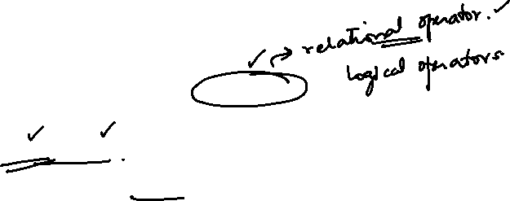
CONTROL STRUCTURE
Control statements :
The flow is altered according to a condition. where the condition is a relational or logical expression whose value will be either TRUE or FALSE.
It is also called as the Selective Structure.
The conditional control statements are
If structure
Switch ... case structure
Object Oriented Programming

Slide 44

Decision-Making statements:
1) If Statement:
In Java, the "if" statement is used to evaluate a condition. The control of the program is diverted depending upon the specific condition. The condition of the If statement gives a Boolean value, either true or false. In Java, there are four types of if-statements given below.
Simple if statement
if-else statement
if-else-if ladder
Nested if-statement
Multi alternative if
Object Oriented Programming

Slide 45
CONTROL STRUCTURE
The Common if has the following format
if ( condition ) block ;
Where the condition may be a relational or logical expression and the block may have a single statement or more than one statements enclosed between { and }.
Example:
if ( marks < =50 )
System.out.println(“Performance Bad , Prepare Well for the next exam”);
Object Oriented Programming

Slide 46
CONTROL STRUCTURE
The if.. else has the following format
if ( condition ) block 1;
else block 2;
Where the condition may be a relational or logical expression
and blocks may have a single or more than one statements.
Example:
if ( marks < =50 ) System.out.println(“Performance not Good , Prepare Well for the next exam”);
else System.out.println(“ Performance Good , Keep it UP”);
Object Oriented Programming

Slide 47
CONTROL STRUCTURE
The Nested if is an if structure in which more than one if
structures are overlapped.
That is , if an if lies within another if , the if structure is called as the nested if. The general format of nested if is
if ( condition 1 )
{
if (condition 2 ) block 1
else block 2
}
else
{
if (condition 3 ) block 3
else block 4
}
Object Oriented Programming

Slide 48
CONTROL STRUCTURE
Example
if ( cust_cat==’A’)
if ( salary < 2500 ) bonus = 1000;
else bonus= 750;
else
if (salary<5000)bonus=1500;
else bonus=0;
In the example, bonus=1000 if customer category is A and
getting salary less than 2500. Or bonus=750 if customer category is A and getting salary greater than or equal to 2500. Or bonus=1000 if customer category is not A and gettingsalary less than 5000, no bonus is given if customer category is not A and getting salary greater than or equal to 2500.
Object Oriented Programming

Slide 49
CONTROL STRUCTURE
The Multi alternative if structure has the following format
if ( condition 1 ) block1;
else if (condition 2) block2;
else if (condition 3) block 3;
.................
.................
else block n;
statement – X;
In the above format, block 1 is executed only if the condition 1
is true. After the execution , the flow goes to the statement – X.
Object Oriented Programming

Slide 50
CONTROL STRUCTURE
If the condition 1 is false, it checks whether the condition 2 is
true. If it is true, block 2 is executed. After the execution , the
flow goes to the statement – X and so on.
If no condition is true , block n is executed.
Note : The multi alternative if structure is also called as the
else if ladder. IfElseIfDemo.java
Selective Structure with switch ... Case statement
This structure is used for doing multi way decisions such as
else if ladder.
It is an alternate structure for else if ladder.
The general format for the switch .. case structure is
Object Oriented Programming

Slide 51
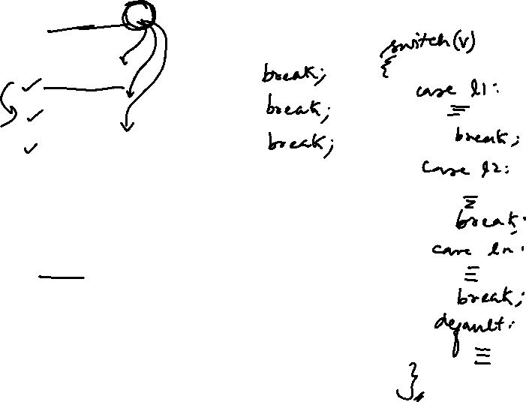
CONTROL STRUCTURE
switch ( e )
{
case op 1: block 1;
case op 2 : block 2;
case op 3: block 3;
...........
............
...........
default: block n;
}
Statement – x;
Object Oriented Programming

Slide 52
CONTROL STRUCTURE
In the above format , e may be an expression or may be character or integer variable.
The options op1 , op2 , ...... are the constant values for e.
Each block except block n has a break statement.
The block 1 is executed if the value of e is equal to op1.
After the block is executed , the flow moves to the statement – x by means of the break statement in the block.
The block 2 is executed if the value of e is equal to op2.
After the block is executed , the flow moves to the statement – x by means of break statement in the block.
The block n is executed if the value of e does not match with any optional values op1, op2, ..... . op n-1 .
After the block is executed , the flow moves to the statement – x automatically.
Object Oriented Programming

Slide 53
CONTROL STRUCTURE
Example for switch .. case
switch (cust_cat )
{
case ‘A’: discount = price * 10.0 / 100;
break;
case ‘B’: discount = price * 7.5 / 100;
break;
case ‘C’: discount = 100;
break;
default: printf(“\n Invalid customer Category”);
discount=0
}
SwitchDemo and SwitchDemo2
Object Oriented Programming

Slide 54
Thanks

